Slide 1
PIP & PAP

Slide 2
PICTURE IN PICTURE (PIP)

Slide 3
Contents
Introduction
Entry and Exit condition
Words and Terms
Various Behavior:
Launch from Single Picture
Launch from P&P
Return to Single view from PIP
Sub screen display position
Input change
Restriction for PIP

Slide 4
Introduction
Picture in Picture (PIP) is a feature of some television receivers and similar devices. One program (channel) is displayed on the full TV screen at the same time as one or more other programs are displayed in inset windows. Sound is usually from the main program only.
Picture in Picture requires two independent tuners or signal sources to supply the large and the small picture. Two-tuner PiP TVs have a second tuner built in, but a single-tuner PiP TV requires an external signal source, which may be an external tuner, VCR, DVD player, or a cable box. Picture in Picture is often used to watch one program while waiting for another to start, or advertisements to finish.

Slide 5
Entry and Exit Conditions
Entry Conditions
<P&P> key is pressed Twice from RC.
“PIP” is selected in Option menu.
Exit Conditions
<P&P/PIP> key is pressed.
<Return> key is pressed.
“Single Picture” is selected in the options menu.
<Select> key is pressed.
<Home> key is pressed (Home Menu is displayed).
Idle TV Standby has been launched.
Power Off
Received Input Select request from CEC or PIN8(SCART).

Slide 6
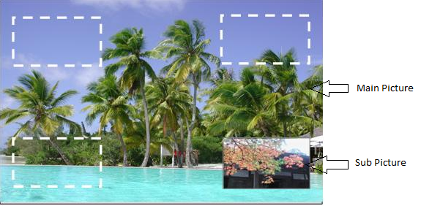
Words and Terms in PIP
Main screen
The area that TV size picture is displayed on.
Sub screen
The area that small size picture is displayed on.
PC signal
Analog PC signal and HDMI (PC signal)

Slide 7
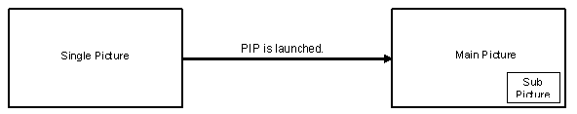
Launch from Single Picture
PIP main picture displays picture that was displayed on the single picture.
PIP sub picture displays picture that was displayed at the last right-side of previous PIP.
In case Analog PC (no signal / unsupported signal / un recommended signal)
Active frame will be Main picture.
The audible source will be present for active frame.

Slide 8
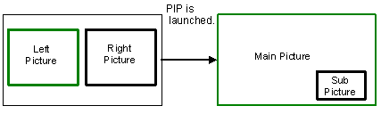
Launch from P&P
PIP main picture displays picture that was displayed at the left picture of P&P mode.
PIP sub picture displays picture that was displayed at the right picture of P&P mode.
If the Right picture is active frame in P&P then sub picture of PIP will have Active frame.
If the Left picture is active frame in P&P then Main picture of PIP will be Active.
The audible source will be present for active frame.

Slide 9
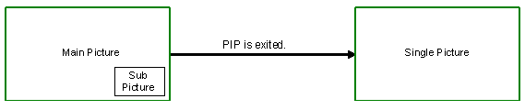
Return to Single view from PIP
When the PIP is exited, active side (= focused picture) of PIP is displayed as single picture.

Slide 10
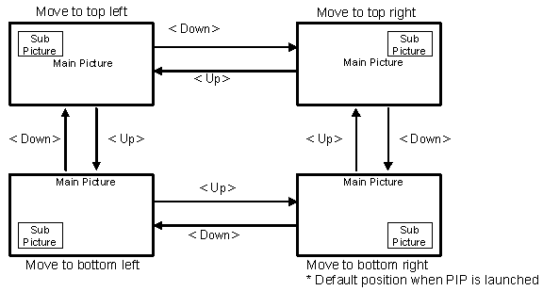
Sub screen display position
To move the sub picture to the next clockwise corner, press <down> key.
To move the sub picture to the next counterclockwise corner, press <up> key.
The position of sub picture is last-memorized. i.e. it is remembered even after AC off/on.

Slide 11
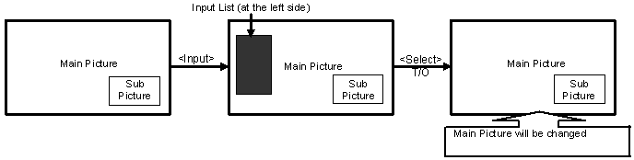
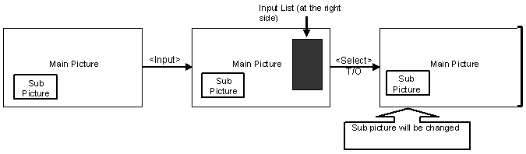
Input change
When the main picture is active, Input List will be displayed at the left-side.
When the sub picture is active, Input List will be displayed at the right-side.

Slide 12
Restriction for PIP
PIP cannot be Launched when the following Application are Running
[AEP/GA] Sony EPG Guide Screen that has preview window
Gemstar
TELETEXT mode is PAT(Picture and Text) mode.
If the TV is 3D display during single picture mode, PIP is not launched
For AEP during SCART Recording, PIP will not be launched and during Recording also we cannot Launch PIP.
[NOTE: During the Above Application If we Press <PIP> Key, respective Clip Error Message is displayed.
Eg: “Feature not available with current input mode”]

Slide 13
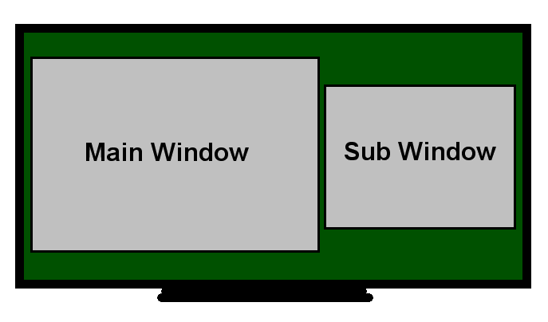
PICTURE AND PICTURE (PAP)

Slide 14
Contents
Introduction
Entry and Exit condition
Words and Terms in PAP
Various Behavior:
Launch from Single Picture
Focus Frame Movement
Input change
Picture Size
Restriction for PAP

Slide 15
Introduction
Picture And Picture (PAP) is a feature of some television receivers and similar devices. One program (channel) is displayed on the Left side of TV screen at the same time as one or more other programs are displayed on the Right side of TV screen. Sound is usually from the Left Picture only.

Slide 16
Entry and Exit Conditions
Entry Conditions
<P&P> key is pressed from RC.
“P&P” is selected in Option menu.
Exit Conditions
<P&P/PIP> key is pressed.
<Return> key is pressed.
“Single Picture” is selected in the options menu.
<Select> key is pressed.
<Home> key is pressed (Home Menu is displayed).
Idle TV Standby has been launched.
Power Off (RC OFF/Main OFF/AC OFF)
Resolution or frequency has changed.

Slide 17
Words and Terms in PAP
Main screen
Screen on the left hand side.
Sub screen
Screen on the right hand side.
Active screen (operation screen)
It is the side of screen surrounded by focus frame in P&P. It can tune, select inputs and so on. This screen’s audio is output audio.
Non-active screen (non-operation screen)
Opposite screen of Active screen

Slide 18
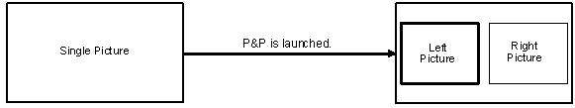
Launch P&P from Single view
P&P left picture displays picture that was displayed on the single picture.
P&P right picture displays picture that was displayed at the last right-side of previous P&P.
If the source is not allowed for right picture, the substitute source should appear.
For its candidate priority order, see the next chapter.
In case single picture of PC / HDMI(PC), P&P cannot be launched, and PIP is launched.

Slide 19
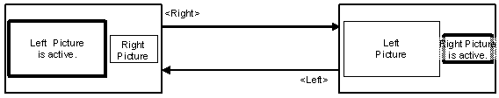
Focus frame movement
Switch Active screen by <Right> or <Left> key.
Press <Left> key to make the left screen active.
Press <Right> key to make the Right screen active
Audio is also switched (it is always output from Active screen).
If HDMI CEC active source is detected, active side is switched to detected input.
Followings are displayed when Active screen is switched by <Right> or <Left> key.
Banner / Signal Information
Message (corresponds to active screen status)

Slide 20
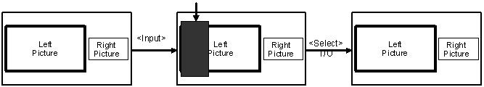
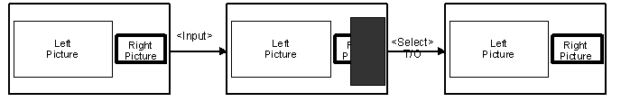
Change Left/Right Picture (<Input> key)
Input List is displayed when <Input> key is pressed.
When the left picture is active, Input List should be displayed at the left-side
Change Right Picture (<Input> key)
Input List is displayed when <Input> key is pressed.
When the right picture is active, Input List should be displayed at the right-side.

Slide 21
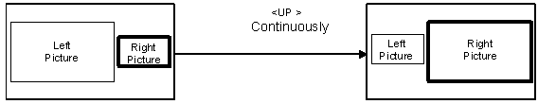
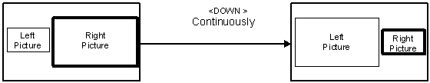
Change Picture size
To enlarge the active side picture, press <up> key continuously and the size of another side picture will be reduced at the same time.
To reduce the active side picture, press <down> key continuously and the size of another side picture will be enlarge at the same time.
The last sizes of left picture and right picture are memorized i.e. they are remembered even after AC off/on. The motion of enlargement/reduction stops for a moment when right & left picture sizes are the same.

Slide 22
Restriction for PAP
PAP cannot be Launched when the following Application are Running
[AEP/GA] Sony EPG Guide Screen that has preview window
Gemstar
TELETEXT mode is PAT(Picture and Text) mode.
NUX home menu which has preview window
For AEP during SCART Recording, PAP will not be launched and during Recording also we cannot Launch PAP.
Single picture of PC / HDMI(PC), P&P cannot be launched. But PIP can be Launched
[NOTE: During the Above Application If we Press <PAP> Key, respective Clip Message is displayed.]

Slide 23
Screen Transitions
Let us see the Available Combination to Launch PAP and PIP in different Inputs(HDMI, PC,Analog,Digital) for different regions(AEP,GA,UC..)

Slide 24
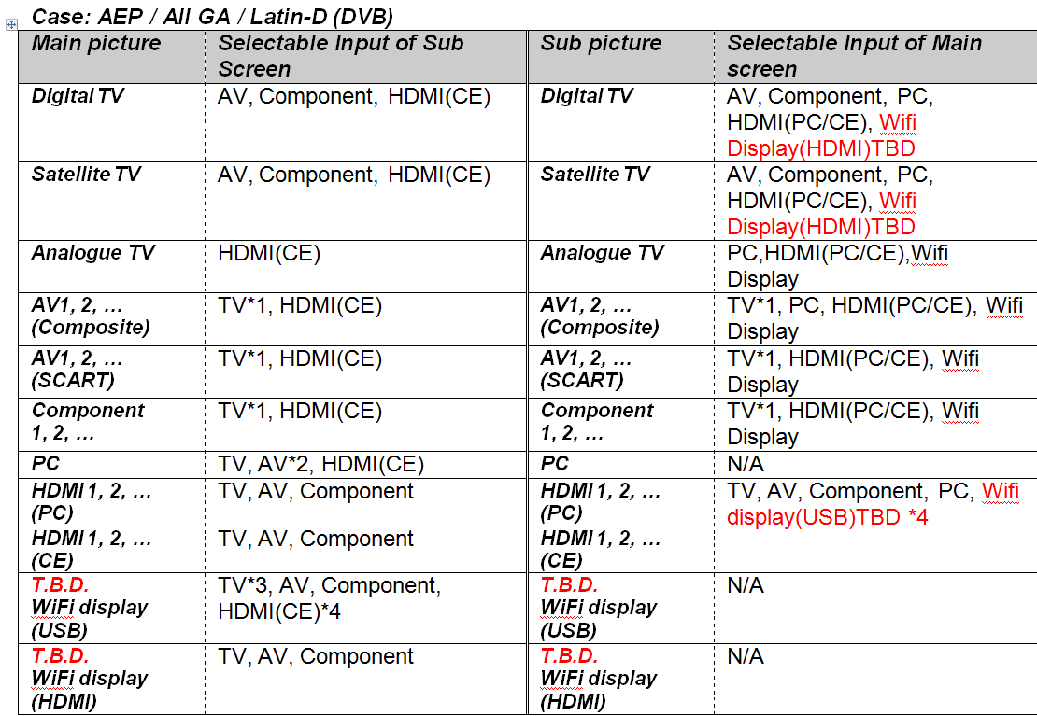
Selectable Input for PIP

Slide 25
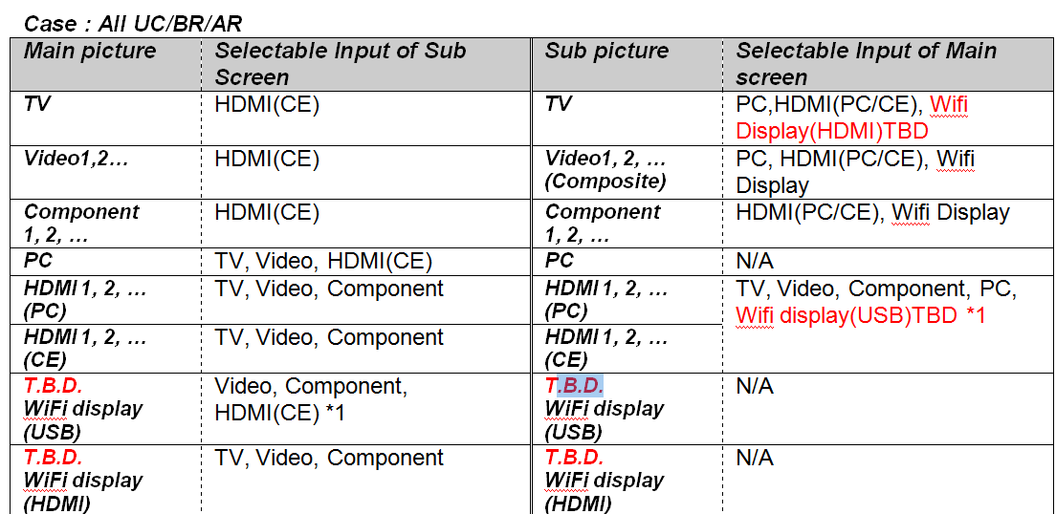
Selectable Input for PIP

Slide 26
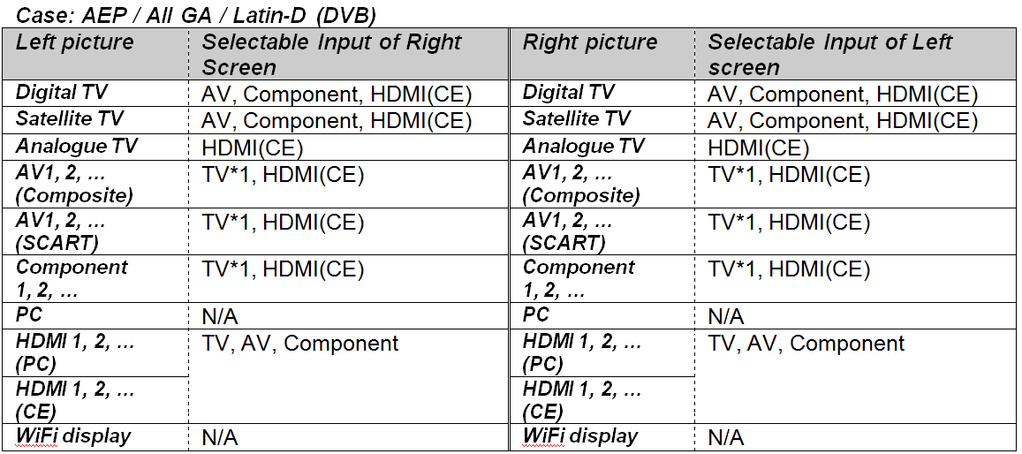
Selectable Input for PAP

Slide 27
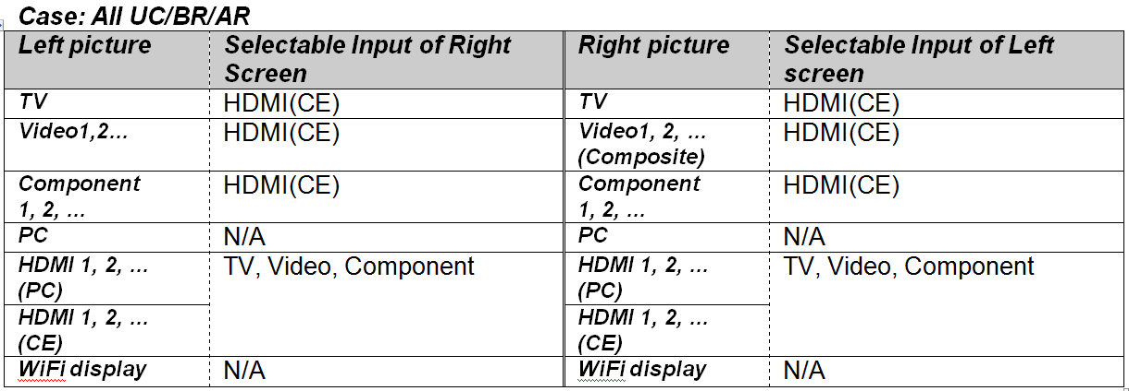
Selectable Input for PAP

Slide 28
Reference Spec
UI_11DTV_PAP.doc
UI_11DTV_PIP.doc

Slide 29


